Slide 1
Introduction to Image Analysis with FIJI
5. 3D Visualization and Analysis
Noreen Walker, Gayathri Nadar
Scientific Computing Facility, MPI-CBG
3.-7.5.2021
Aim of this session:
Understand 3D data
Tools for 3D data visualization
Tools for 3D data analysis
With material from:
Robert Haase
Benoit Lombardot

Slide 2
Course schedule
Day 1 (Mon 3.5.)
Image basics, visualization, measurements
Spot detection
Segmentation (start)
Day 2 (Tue 4.5.)
Visit LMF
Segmentation (cont’d)
Mathematical background: image filters, morphology
Day 3 (Wed 5.5.)
Advanced segmentation: Machine learning with Ilastik
IJ Macro (start)
Day 4 (Thu 6.5.)
IJ Macro (cont’d)
3D data: visualization and analysis
Day 5 (Fri 7.5.)
Image registration, image stitching
Time sequence analysis and tracking
Good practices

Slide 3
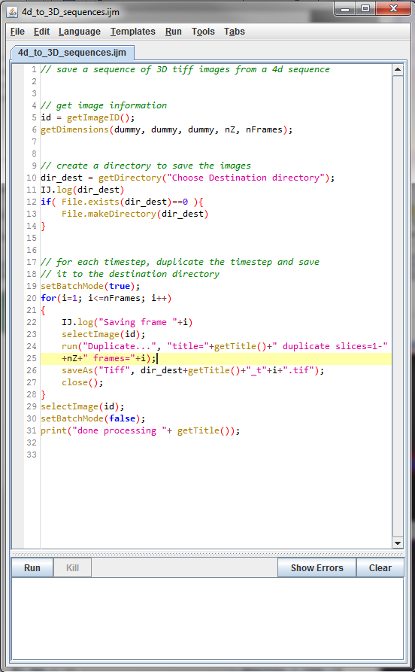
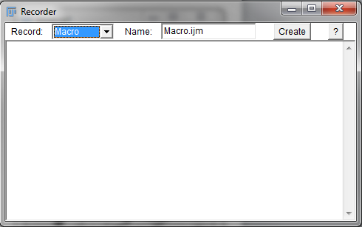
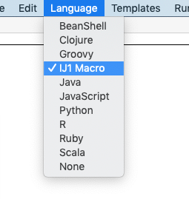
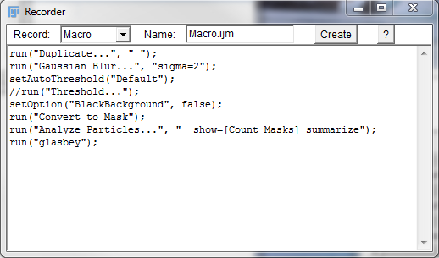


Recap
Macro basics
Macro recorder
Macro for Images
Good practices
imageTitle = getTitle();
// do fancy processing here
...
// select original image again
selectWindow(imageTitle);
A = w * h;
print( A );
Built-in command
Stack.getDimensions(width, height, channels, slices, frames)
Stack.getPosition(channel, slice, frame)
area = width * height;
print( area );

Slide 4
Overview
Introduction: 3D Data
Visualization of 3D Data in Fiji
Manual analysis of 3D data
Automatic 3D Processing & Analysis
Other software
Notes:
We’ll show a few tools in depth, and give an overview of many more plugins

Slide 5
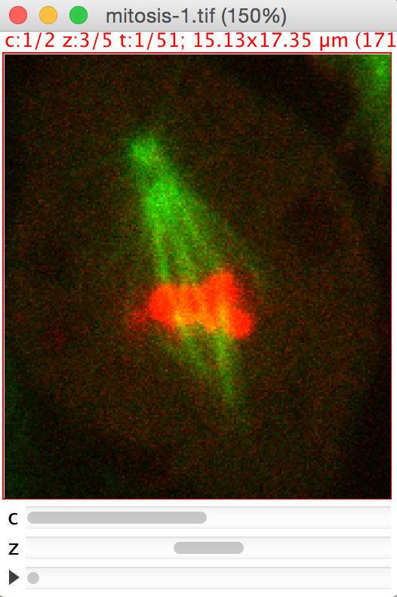
Introduction
3D Data

Slide 6
3D Image Data
3D image data are more difficult to handle than 2D data
Our screen is 2D: information loss when visualizing
Harder to get “an intuition on the data” and interact with it
Large data size
Tools are often better developed for 2D
“3D” means in this tutorial:
3D or higher dimensional: (X,Y, slices, channels, frames)

Slide 7
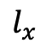
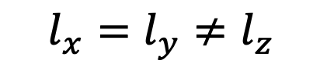
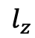
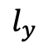
Data Anisotropy
3D image data is usually anisotropic.
Exception: reconstructed multi-view light sheet data
An-iso-tropy, from Greek:
ἀν- (not)
ἴσος isos (equal)
τρόπος tropos (rotation, direction)
“Not the same in any direction”
Usually in 3D image processing:
Image analysts love to have isotropic voxels, but it’s often not possible.
$$l_{z}$$
$$l_{y}$$
$$l_{x}=l_{y}≠l_{z}$$
$$l_{x}$$

Slide 8
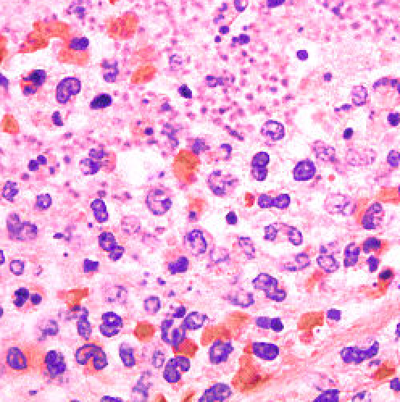
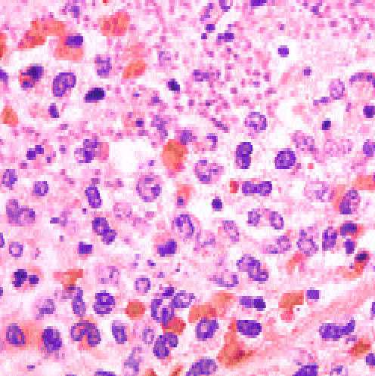
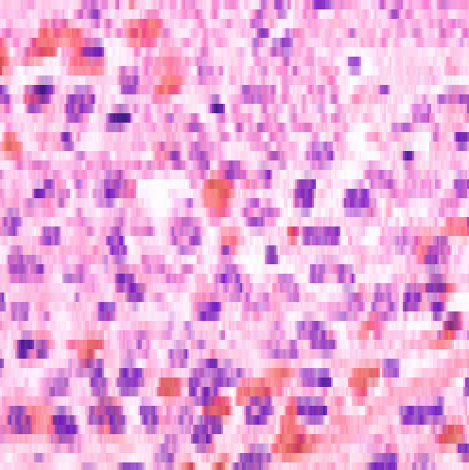
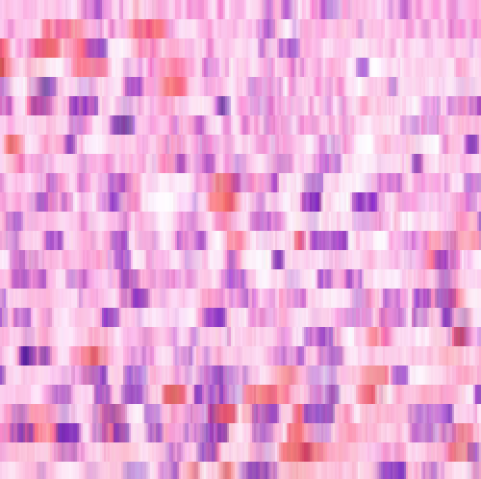
Data Anisotropy
Voxel size has immediate impact on image quality and thus, on processing / analysis results.
z
x
x:z (voxel size)
1:1
250 x 250 px
1:2
250 x 125 px
1:5
250 x 50 px
1:10
250 x 25 px

Slide 9




Slice distance versus slice thickness
What you may have measured using microscopy:
What you see when processing 3D images:
$$z$$
$$z$$
$$z$$
$$x$$
$$x$$
$$x$$
Slice distance and slice thickness may be different but many image processing tools ignore that!
Undersampling (left) is the typical issue.

Slide 10
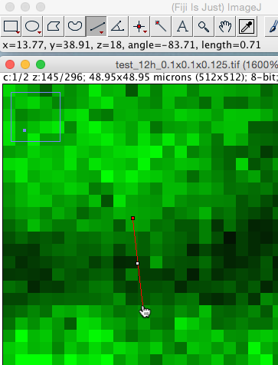
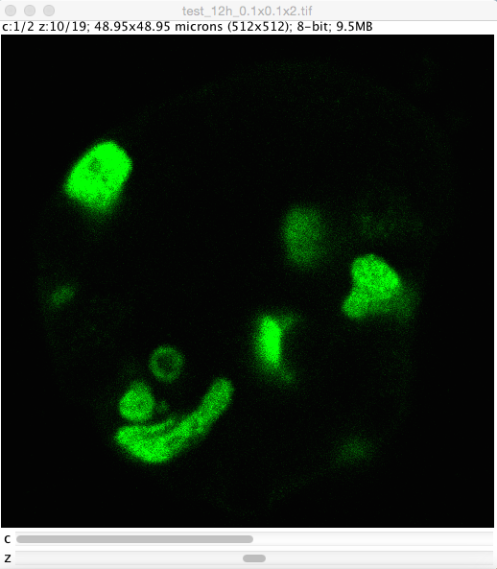
Nyquist–Shannon sampling theorem
Voxel size in Z-dimension should at least be half the size of the object you are interested in (even better: a third). Further reading: https://en.wikipedia.org/wiki/Nyquist-Shannon_sampling_theorem
Measure the size of a gap between cells, e.g. in a highly resolved 2D-image.
Image source: Elena Gromberg, Tanaka Group, CRTD Dresden

Slide 11
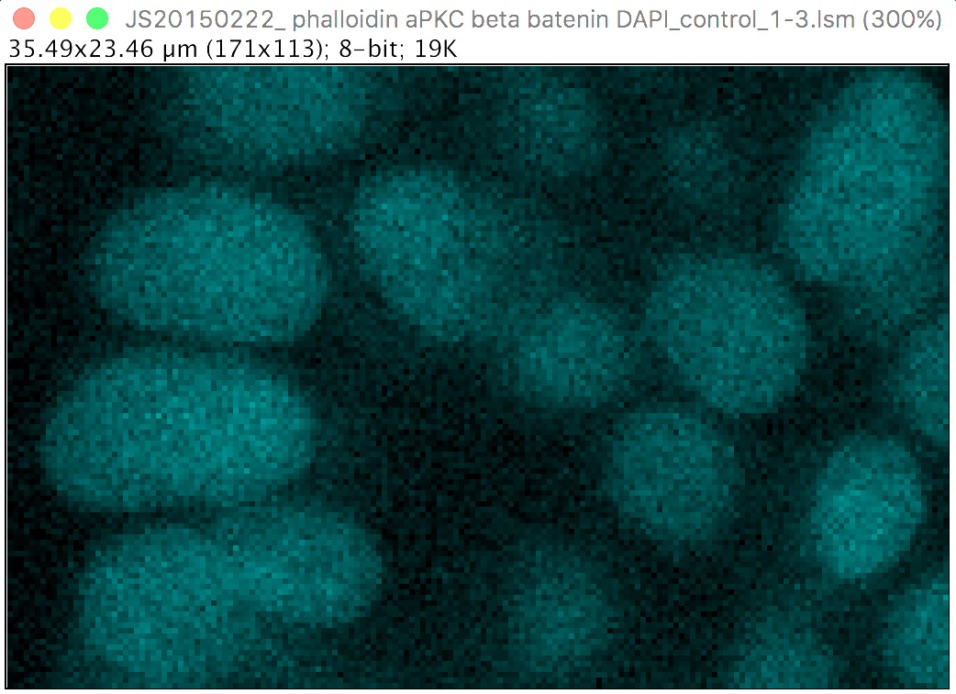
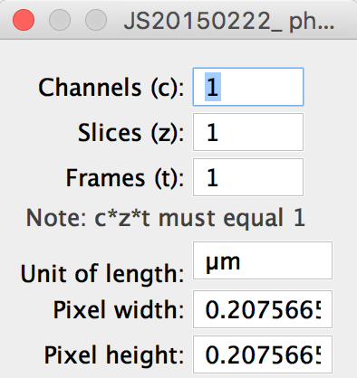






Quiz
This is a 2D image of our sample on which we did some distance measurements. Now we would like to go for 3D imaging. What would be a good slice distance configuration?
$$1.5μm$$
$$6 μm$$
$$9 μm$$
Image source: Jaydeep Sidhaye, Norden lab, MPI CBG
$$0.207566μm$$
$$0.5μm$$
$$3μm$$
Notes:
0.5

Slide 12
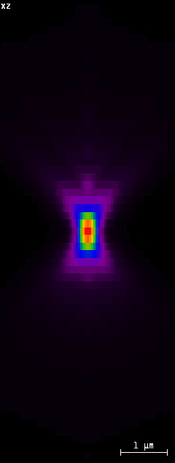
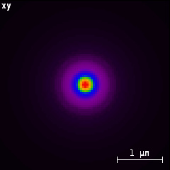
Optical resolution
The image of a point is not a point.
Keywords: Point spread function (PSF), Airy disk
The optical resolution in axial direction (z) is lower than in lateral direction (x,y).
Confocal microscope
PSF images from SVI Huygens Nyquist calculator: https://svi.nl/NyquistCalculator
Notes:
Usually undersampling in z is the bigger issue. But if sampled high enough: consider deconvolution for resolution improvement

Slide 13
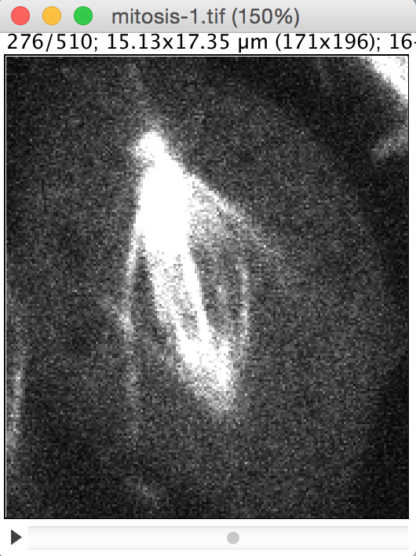
Opening Images: Bio-Formats
If an image stack does not appear as it should be (missing colours, wrong number of slices/frames/channels)…
Or if an image is in a proprietary microscope vendor format …

Slide 14
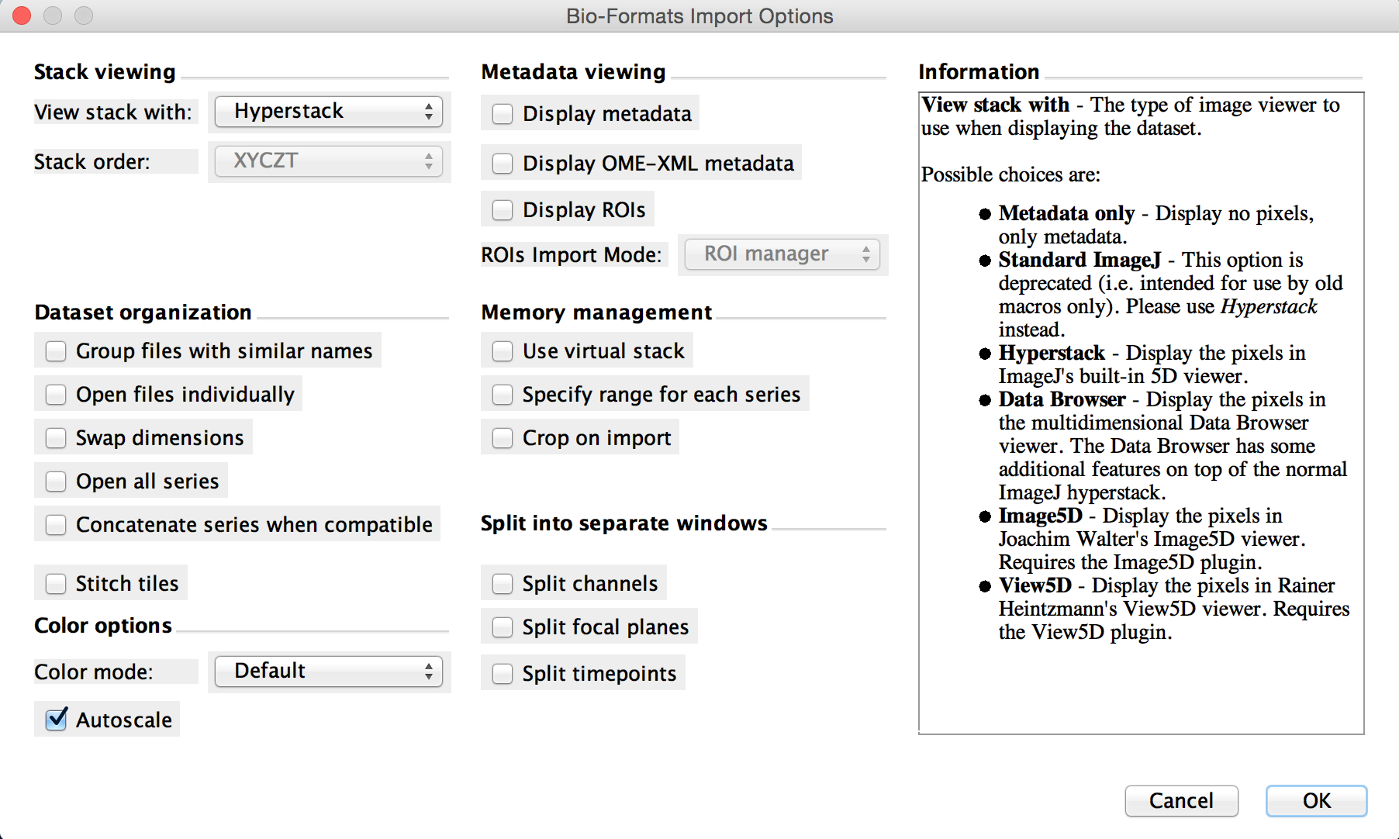
Opening Images: Bio-Formats
… use the BioFormats importer
File > Import > BioFormats
Use virtual stack:
For huge files
For quick preview
Specify range:
Load a subset of the stack

Slide 15
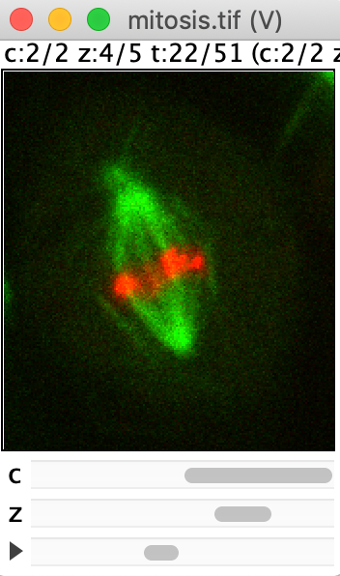
Virtual Stack
If dataset does not fit into memory use virtual stack
Only current slice is loaded into RAM
Use for quick preview of large data:
Fast since not full stack needs to be loaded
Read-only:
Cannot be modified
Some plugins can be used (e.g. Z Projection – the result is not virtual any more), many cannot be used.
Notes:
If you struggle with large data: consider also downscaling, and bit conversion

Slide 16
Fiji/ImageJ and 3D
ImageJ originally developed for 2D analysis:
Examples of 2D concepts: ROIs, Particle Analyzer, …
Many (older) plugins work on 2D only or process the image slice-by-slice
For 3D analysis:
ImageJ extended by lots of community plugins (activate the update sites)
Check the documentation if your plugin of choice is designed for 3D
Stacks versus Hyperstack (Fiji terminology):
Some plugins make a distinction between Stacks (3D) and Hyperstacks (4D, 5D).

Slide 17
Fiji/ImageJ: Update Sites
List of useful Update Sites for 3D visualization & analysis:
3D ImageJ Suite (3D manager, segmentation+analysis tools)
BigDataProcessor2 (preprocessing, cropping, alignment, ..)
BigStitcher (stitch large images)
Bio-Formats (load microscopy image data)
ClearVolume (3D volume renderer) -> not maintained any more
Clij / Clij2 (fast image processing on GPU)
IJPB-Plugins (MorpholibJ: segmentation+analysis tools)
ImageScience (Feature computations, transformations)
SCF MPI CBG (segmentation+analysis tools)
+ more
How to follow an update site:
Help > Update… > Manage Update Sites > check the boxes of the update site you want to follow > Close > Apply Changes.
Notes:
Add the update sites (except for BigStitcher = not needed today)

Slide 18
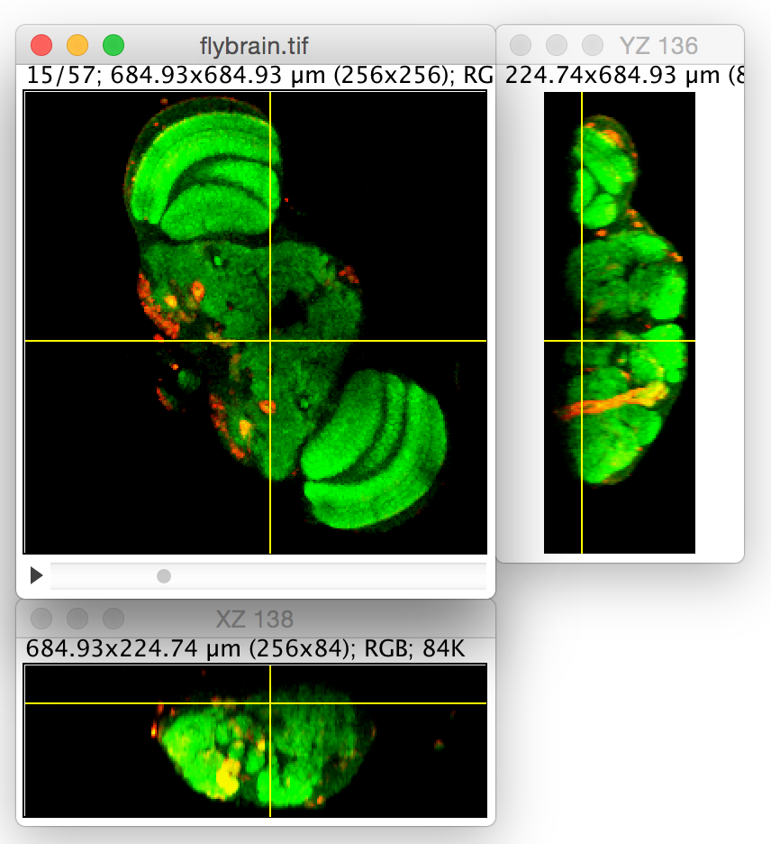
Visualization of 3D Data

Slide 19

Visualization of 3D data
The problem:
Computer screen is 2D.
The 3D images have to be mapped to 2D somehow to visualize them.
Potential solutions:
Slicing / Reslicing
Projections
Rendering
Careful:
Dimension reduction -> information loss.
Good for visualization, but the actual analysis should usually be done in 3D.

Slide 20
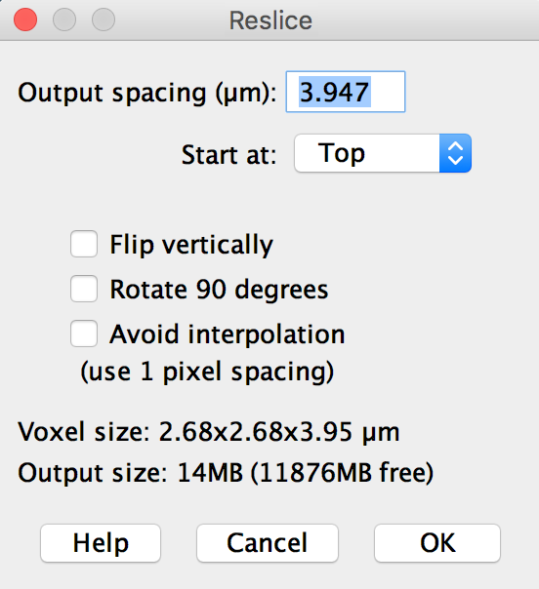
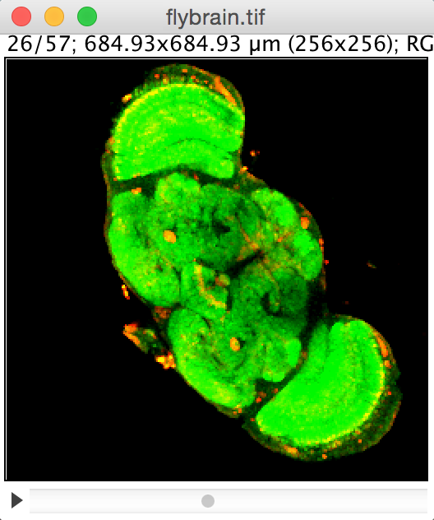
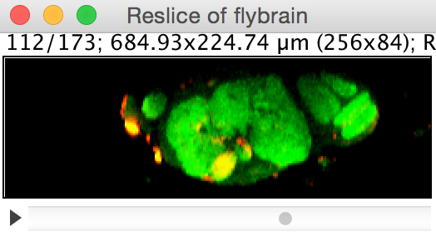
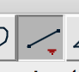
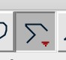
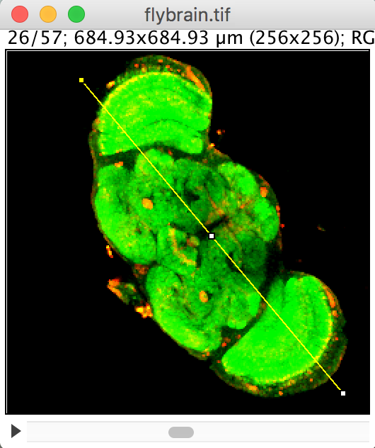
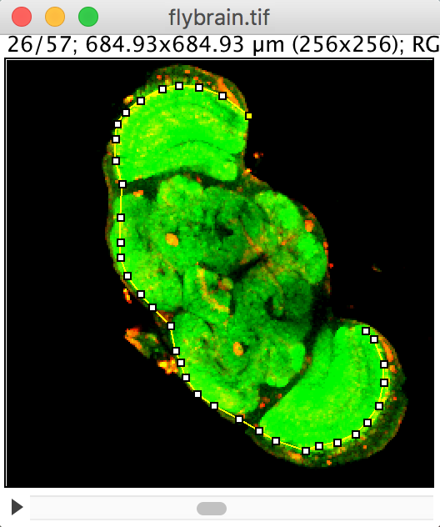
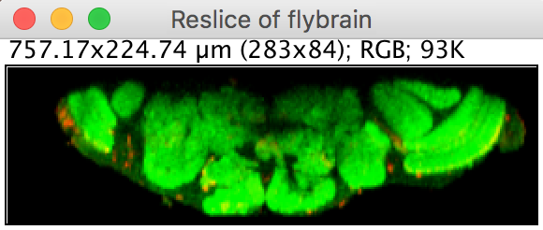
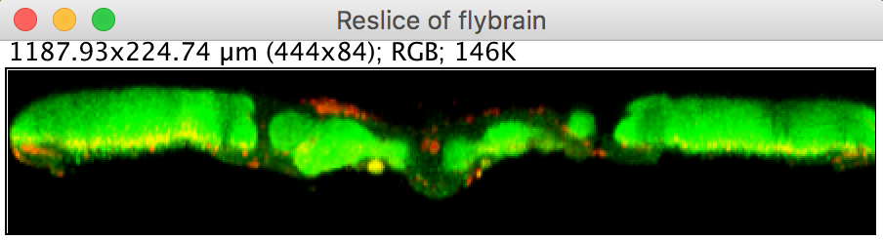
Reslicing
Image > Stacks > Reslice [/]…
Reslice full stack
Keep in mind: voxels are anisotropic
Reslice along selection

Slide 21
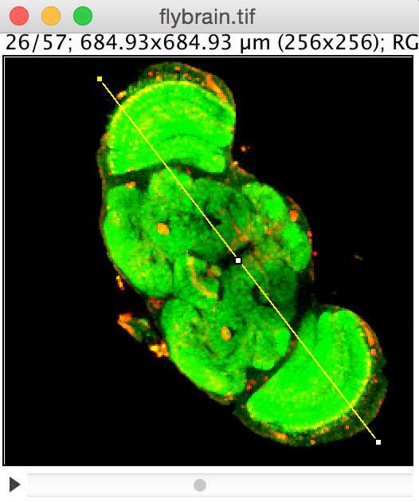
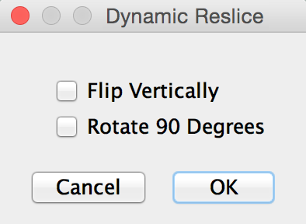
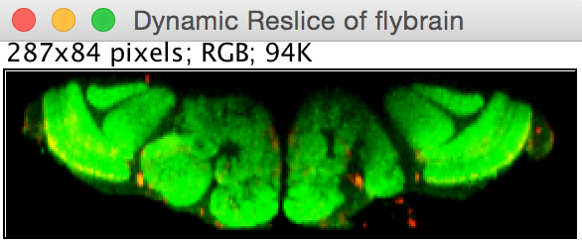
Reslicing
Image > Stacks > Dynamic reslice
Move the yellow line by dragging the center point
If strange results: split channels

Slide 22
Orthogonal views
Image > Stacks > Orthogonal Views
Move the yellow cross by dragging the center point

Slide 23
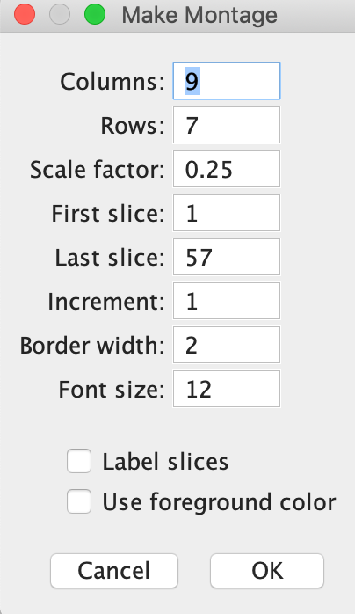
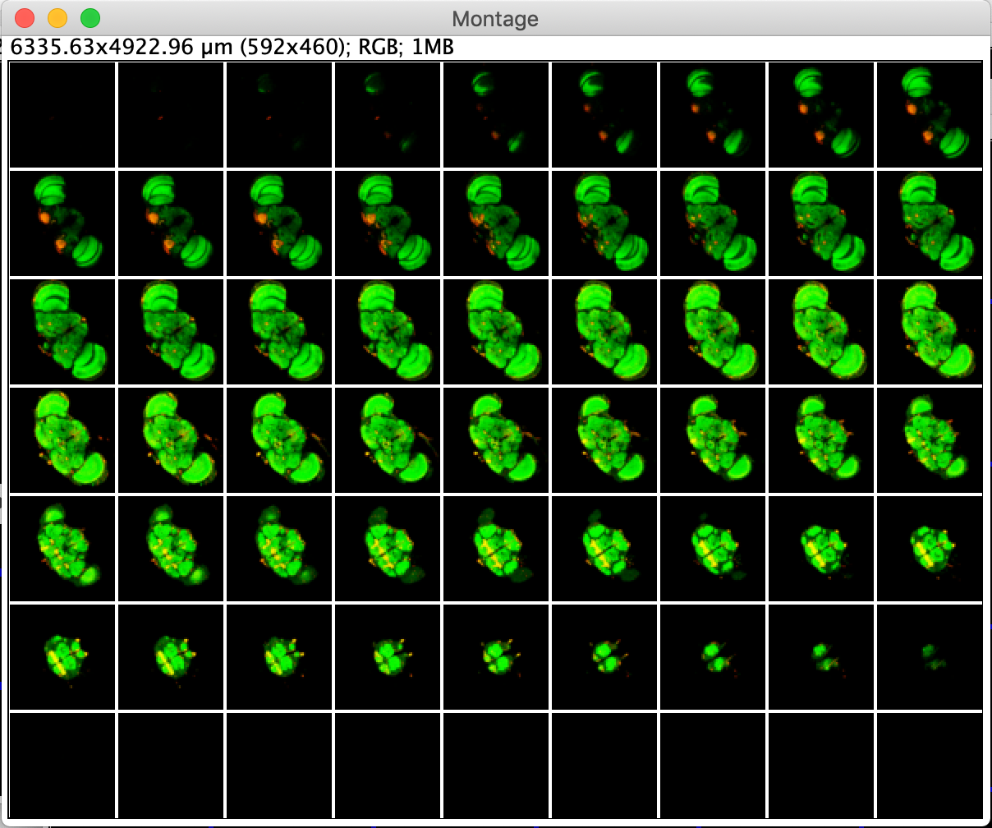
Montage
Image > Stacks > Make Montage…

Slide 24
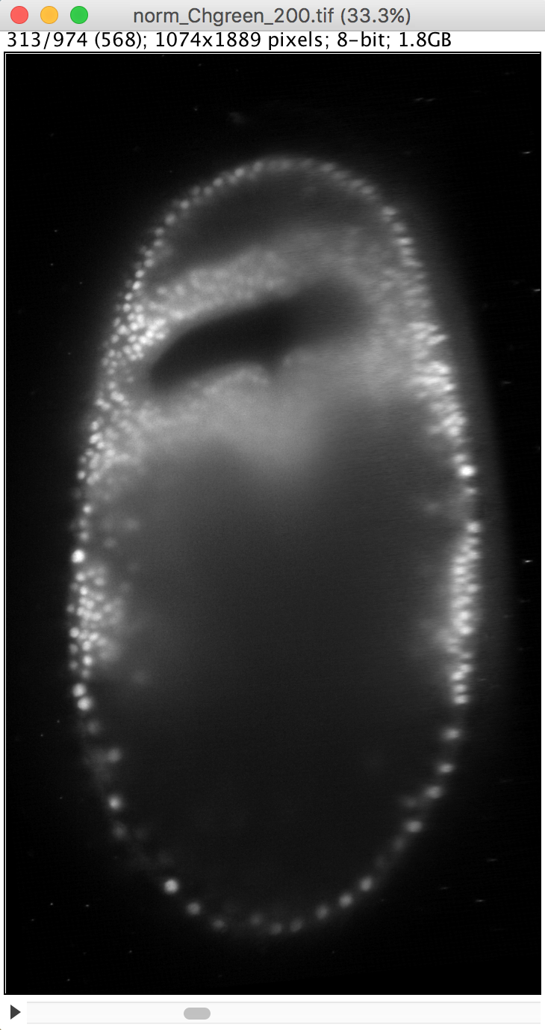
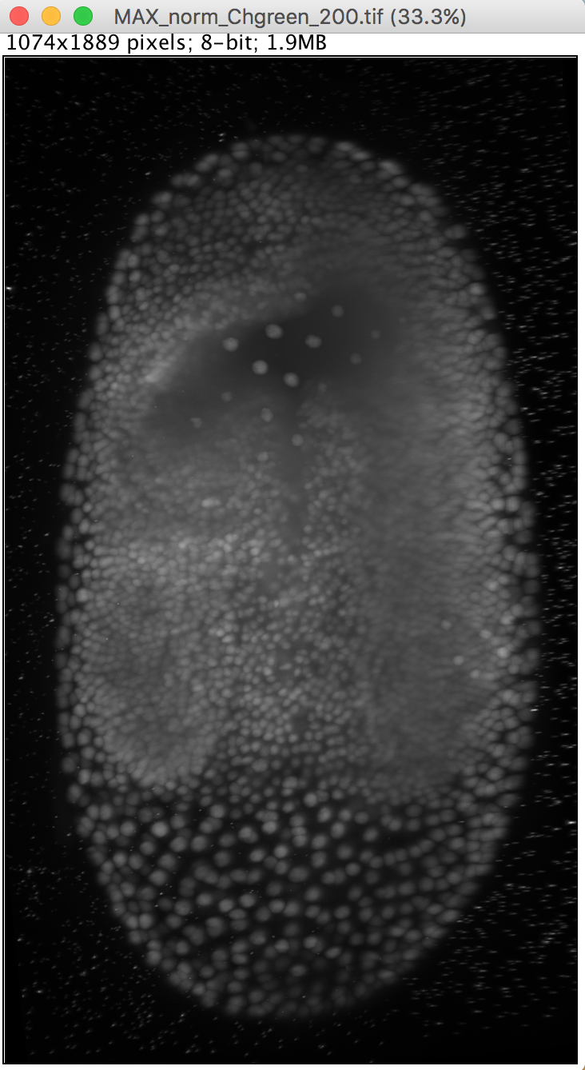
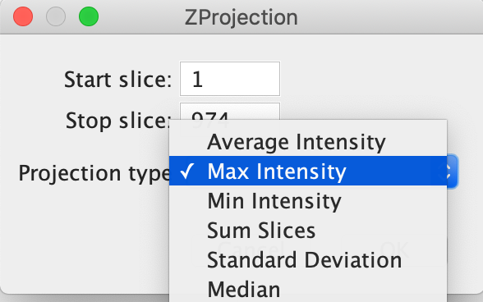
Projection
Image > Stacks > Z-Project…
Maximum intensity projection usually works well for visualization
But check which projection is best for your use-case.
For example a Sum projection to measure the total intensity.
Image source: Akanksha Jain, Tomancak lab, MPI CBG

Slide 25
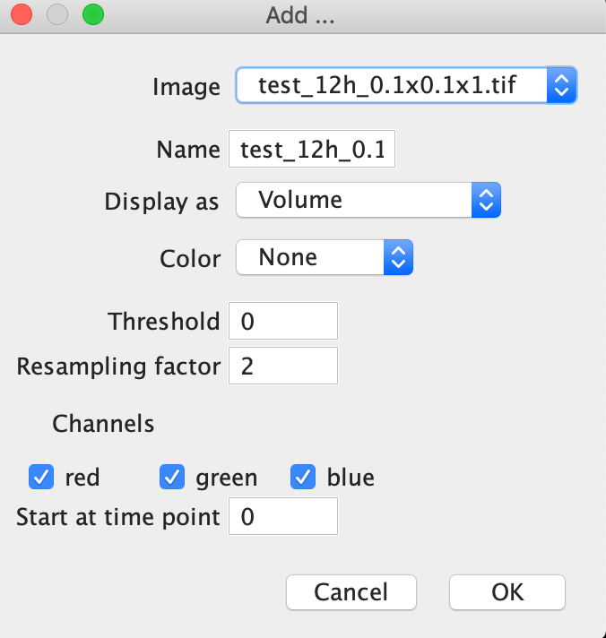
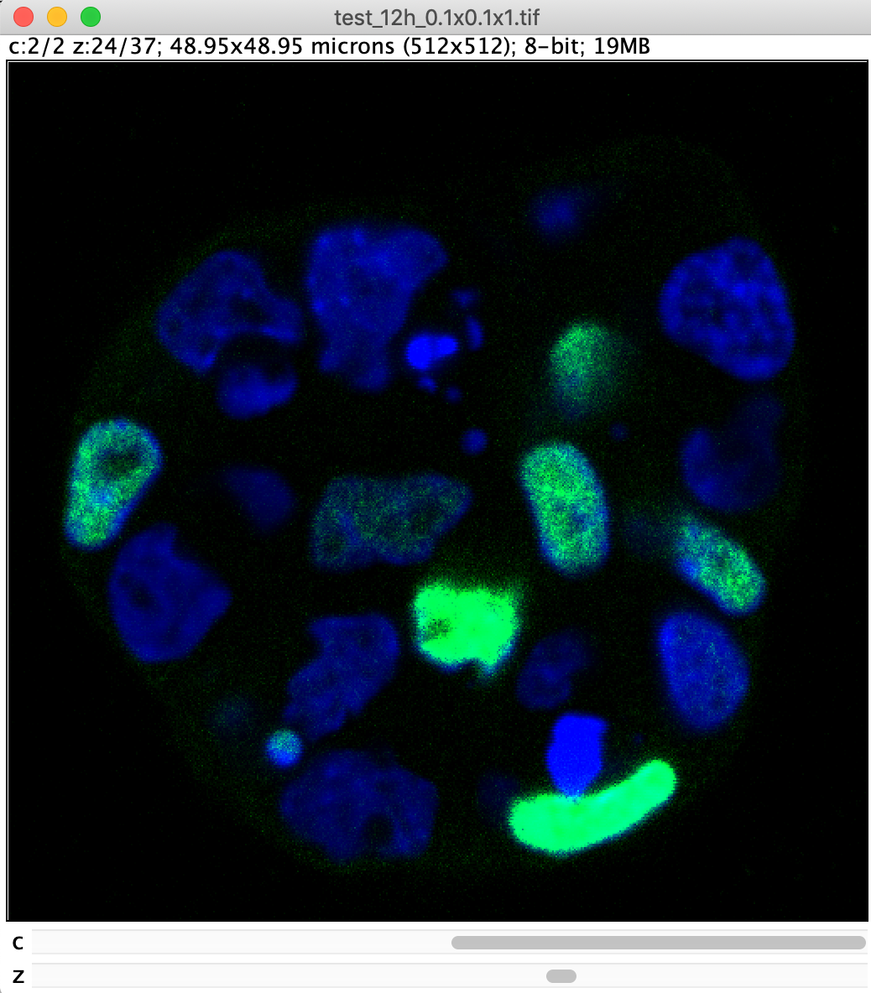
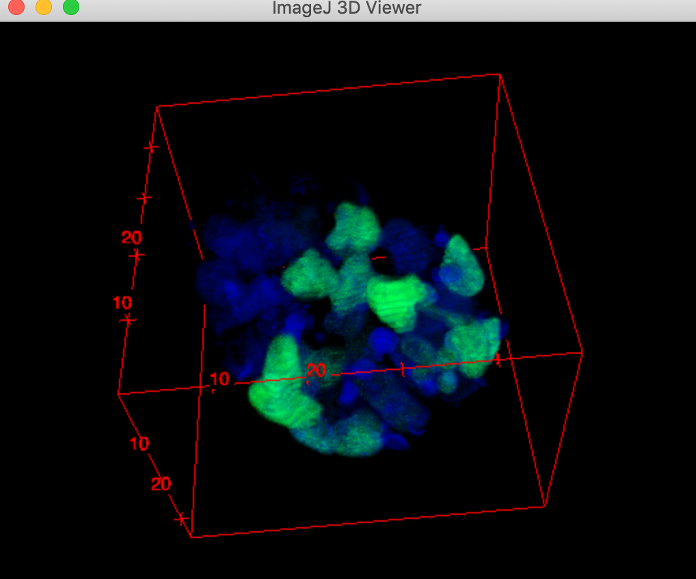
ImageJ 3D Viewer
Plugins > 3D Viewer
“Volume rendering”
Already a bit older but uncomplicated and easy to use viewer
Image source: Elena Gromberg, Tanaka Group, CRTD Dresden
Notes:
Also has movie recording capabilities
“ Volume rendering”

Slide 26
ImageJ 3D Viewer
Navigation:
Click and move the mouse to turn perspective. This depends on where you click!
Hold the SHIFT key while moving to move the view in plane
Use the mouse wheel to zoom in
3D Viewer has also simple movie recording options: View > Start/Stop freehand recording
Notes:
Also has movie recording capabilities

Slide 27
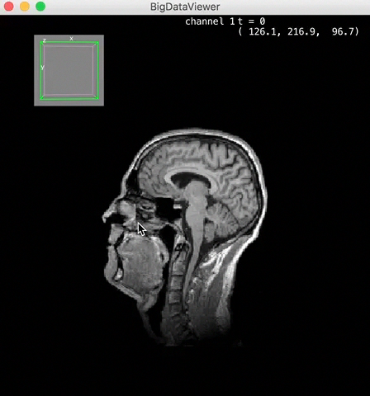
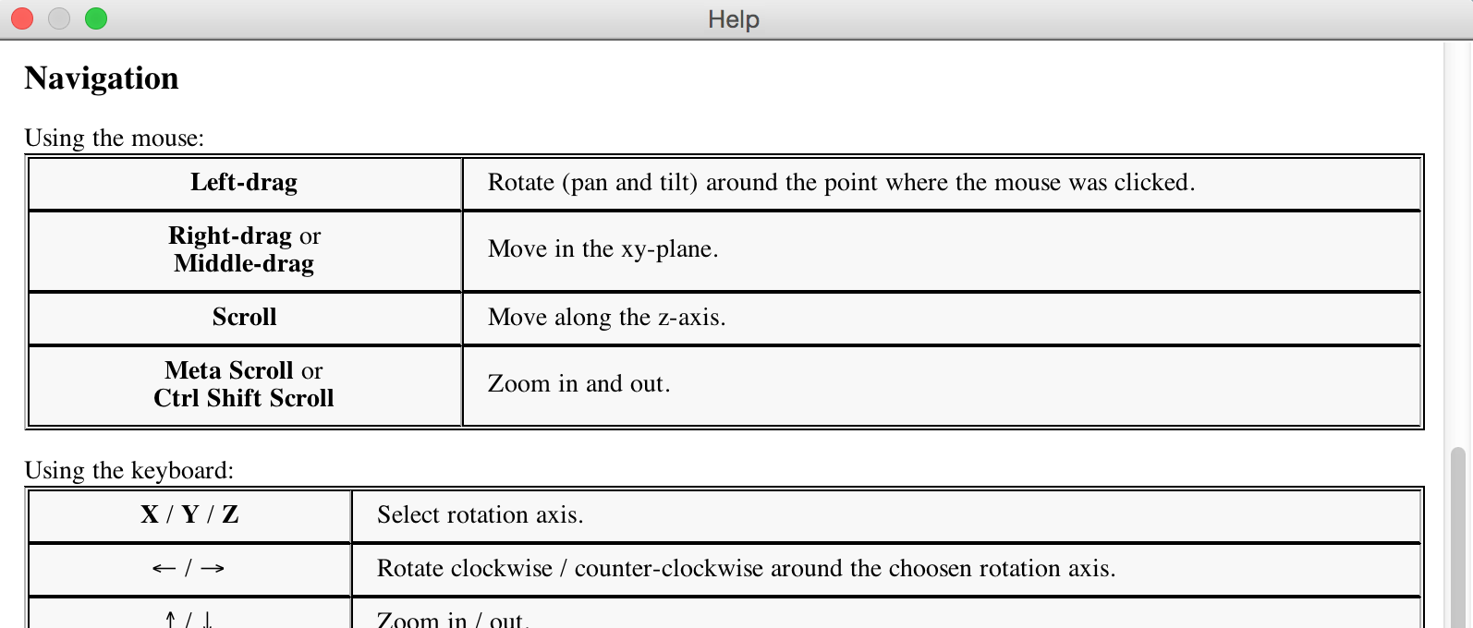
BigDataViewer
Plugins > Big Data Viewer > Open Current Image
BigDataViewer is a re-slicing browser.
Works on huge data sizes (TB’s).
Large data should be saved in native XML/HDF5 format and be loaded from disk.

Slide 28
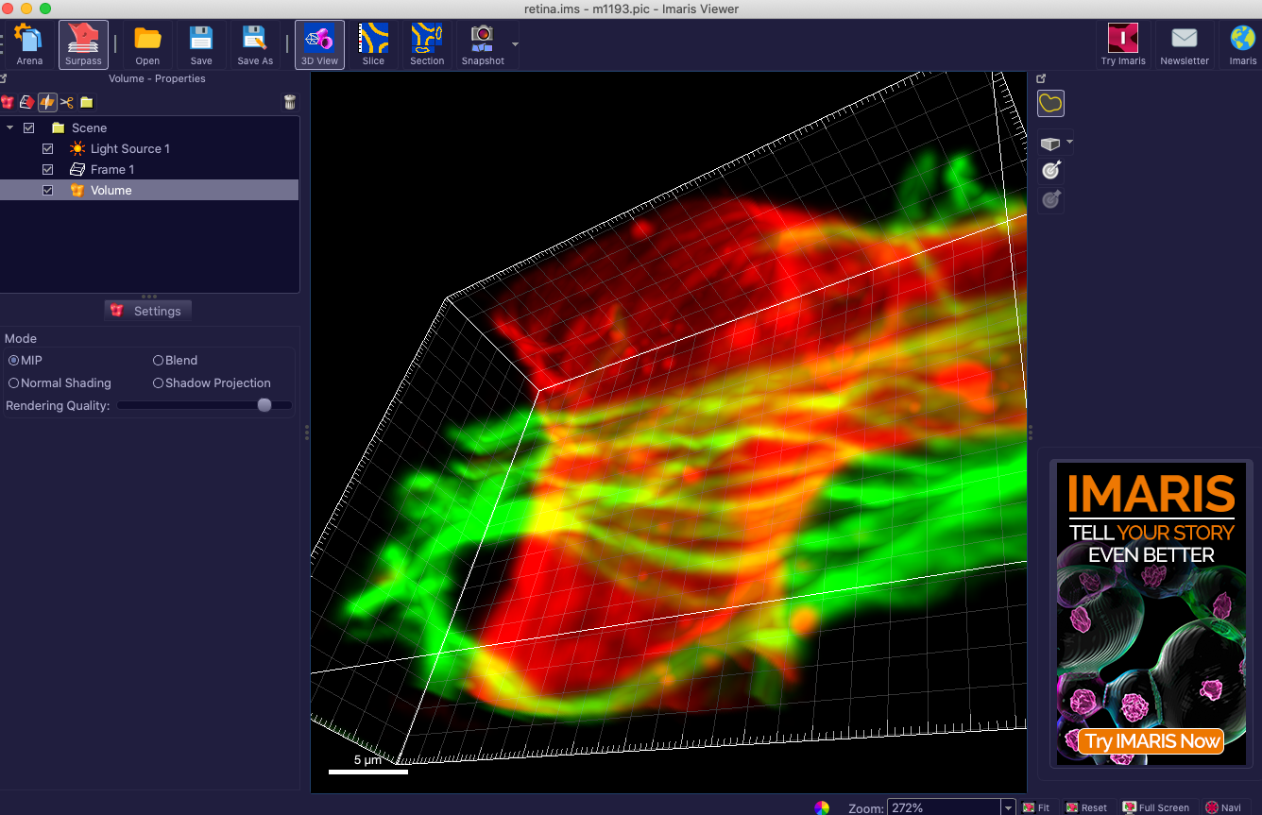
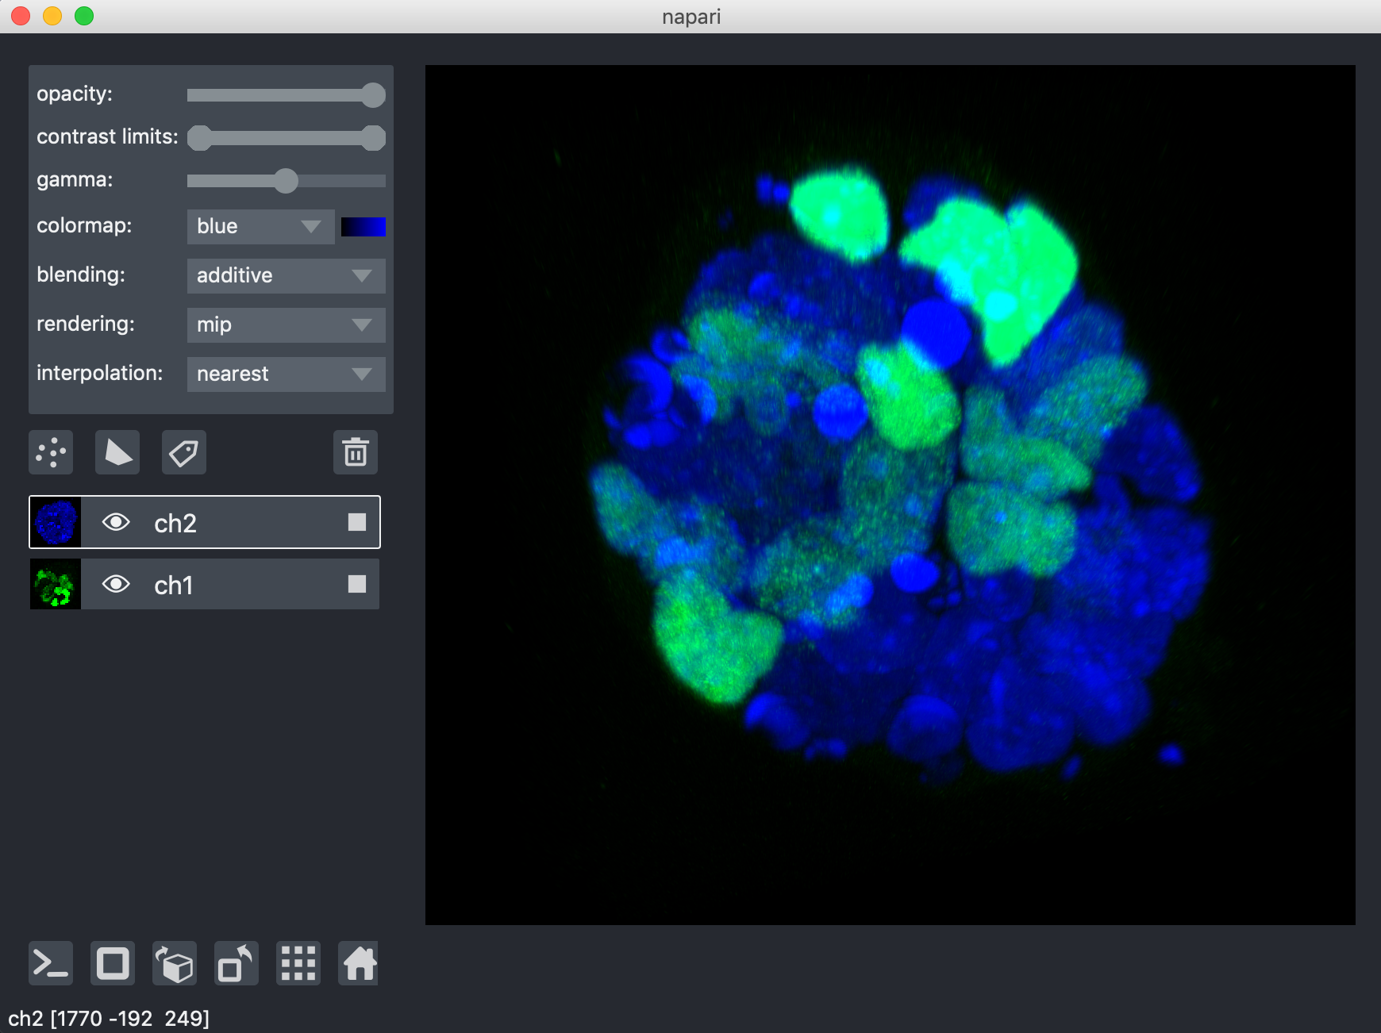
Other tools: 3D visualization
There are more tools for 3D visualization (and processing). Examples:
Imaris viewer (standalone)
Free viewer, for processing: commercial Imaris software
Napari (python)
3D renderer for python

Slide 29
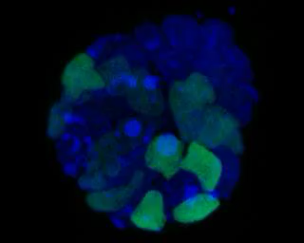
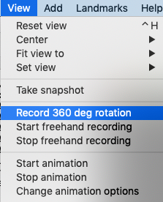
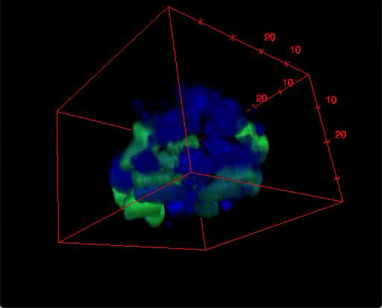

Creating Movies
Image > Stacks > 3D Project…
Very basic but quick, only rotations
3D Viewer
Basic but quick, more options
QuickTimePlayer
If you are on a MacOS you can also record manual rotations with QuickTimePlayer.
Notes:
Which tool is good for you depends on your data and how fancy the movie has to be

Slide 30




Creating Movies
Imaris (commercial software)
Many options, keyframe based animation
3D script
Plugins > 3D script > Interactive Animation
Many options, reproducible results
https://imagej.net/3Dscript
Notes:
3d script: sometimes stripes in rendering

Slide 31

Demo/Exercise: Explore Visualizations
Open test_12h_0.1x0.1x1.tif
2D visualizations:
Reslice [/]
Orthogonal views
Z Project
Montage
Duplicate, then split the channels, then draw a line and explore Dynamic Reslice.
3D rendering:
View the image in all 3 viewers: 3D viewer, BigDataViewer.
Navigate: Rotate the view, shift, scale
BigDataViewer: Use ”Help” to see shortcuts.

Slide 32

3D Processing & Analysis:
(1) Manual analysis

Slide 33
Manual measures
Strategies for manual measures:
Counting:
Point Tools can be used for 3D measures
Alternative: Plugins > Analyze > Cell Counter
Segmentation:
Manual outlining in several slices, then interpolation
Reslicing to reduce dimensionality
only if scientifically sensible
With projection or straighten tools
Notes:
"reduce dimensionality": possible for e.g. sum intensity, not possible for e.g. colocalization, volume
measure

Slide 34
Tools for manual segmentation
Use case: one or a few large objects, use for example for a quick volume measurement
Segmentation Editor
Plugins > Segmentation > Segmentation Editor
Already quite old but still works.
+ other software (Imaris, ITKSnap, ….)

Slide 35

Segmentation editor
Check the 3D button
Draw a ROI into one slice (Freehand tool)
Draw a ROI into a second slice
Press ”I” (interpolate)
Press “+” to add the selection to the Labels. The selection is also painted into the label image.
Repeat from ROI drawing.

Slide 36


Demo/Exercise: Manual segmentation
Open “T1 Head” from sample images.
Goal: segment the brain region and visualize in 3D.
Open the segmentation editor Plugins > Segmentation > Segmentation Editor
Use freehand tool, check 3D box, draw ROIs in a few slices
Use “I” to interpolated the ROIs
Then use “+” to add to the red label.
Verify the created image: Did a red volume appear?
Repeat “draw rois, interpolate ,add” if needed, then press OK.
Use the 3D viewer for visualization of the segmentation.
Bonus: visualize the grayscale image of the brain. Multiply your mask and the raw image (Process > Image Calculator… > check 32bit, new window), then use the 3D viewer.
Tip: if your image looks very strange: change the LUT to Grays.

Slide 37



3D Processing & Analysis:
(2) Automatic segmentation & analysis

Slide 38



Recap 2D: Finding Objects
Object detection
Point/Box per object
Use cases:
Counting
Tracking spots
Object segmentation
Outline per object
Uses cases:
Shape quantification
Spatial relation of objects
Notes:
Detection is easier
Spatial relation between objects: e.g. neighbors, what is inside/outside of cells

Slide 39

Recap 2D: How to split an image into regions?
Many methods for segmentation exist.
Image by: Ignacio Arganda-Carreras, Biological Image Reconstruction and Analysis Course, 2016

Slide 40





Recap 2D: Typical pipeline
Preprocessing
Segmentation
Postprocessing
Analysis
Preprocessing
Deconvolution
Denoising/ Smoothing
Data reduction
Background correction
….
Segmentation
Thresholding
Pixel classifiers (machine learning)
Region growing
Edge based segmentation
…
Postprocessing
Morphological operations:
Watershed
Fill holes
Opening/Closing,…
…
Analysis
Counting
Measure properties
…

Slide 41
3D Image processing
In 3D, the same concepts as in 2D can be applied:
Image filtering, Morphological operations
Thresholding
Pixel Classification
Region Measurements
…
But:
Configuration may be more complicated (Anisotropy),
The implementation of the tool must be designed for 3D.
Check your tool beforehand!
Fiji plugins are often 2D. Special plugins for 3D exist.
Inverse case: If tools is for 3D, it very often also works for 2D.
3D is computationally more expensive: more time and memory required
Proofreading and visualization is more difficult.

Slide 42





Classic segmentation pipeline – in 3D
Lots of plugins for 3D processing exist – they are just in different menus:
Image > Stacks
Process > Filters
Plugins > MorpholibJ
Plugins > 3D

Slide 43


Getting started with 3D processing
Working with large 3D data can be cumbersome. Tips:
Reduce data size for exploration: crop, use a subset
Acquire a small test dataset
BigDataProcessor2
interactive processing of TB-sized image data
Cropping, binning, transformations, …
https://github.com/bigdataprocessor/bigdataprocessor2
More tips for opening large data: How-To Guides (https://mpicbg-scicomp.github.io/ipf_howtoguides/guides/Fiji_OpenLargeData )

Slide 44




Preprocessing: Denoising
2D Gaussian Blur Filter
Process > Filters > Gaussian blur
Using the 2D filter did not produce an error!
But: The filter blurs the stack slice by slice – it acts on 2D images and does not blur along z.

Slide 45


Preprocessing: Denoising
3D Gaussian Blur Filter
Process > Filters > Gaussian blur 3D
3D data should be processed with 3D filters.
But: If your data is very anisotropic a 2D filter can be more appropriate.
Notes:
voxel

Slide 46



Quiz
Filtering uses the local environment of each pixel to compute a new pixel value – for example the mean.
One possible neighborhood in 2D has 8 pixels (“8-connected”).
How many neighbors are in the equivalent 3D neighborhood?
$$6$$
$$15$$
$$26$$
Notes:
26

Slide 47



Thresholding
Image > Adjust > Threshold
For 3D Data we want one threshold value for the whole image
Use settings:
Use the Stack histogram
Do not calculate individual threshold per image slice

Slide 48

Post-processing: Mask cleanup
3D Morphological operations
Examples:
Erosion, Dilation
Opening, Closing
Remove small objects
Fill holes
Watershedding
Similar to 2D, but use plugins which can do 3D operations:
Plugins > MorpholibJ > Morphological Filters (3D)
Plugins > MorpholibJ > Binary Images
Plugins > 3D > 3D Fill Holes
Etc.

Slide 49




Postprocessing: Binary Watershed
Watershed
Split touching objects.
Model: Objects are roundish and touch at a “thin neck”.

Slide 50


Binary Watershed
Binary watershed cuts objects in a binary segmentation where “it is reasonable” (where they have a thin neck).
Starting from seed points (minima or maxima), the image is being flooded until a intensity limit is reached.
For each seed point, one object is created.
Plugins › MorphoLibJ › Binary Images › Distance Transform Watershed
Note: Directly creates a Label Image
Binary segmentation
Distance map
Notes:
Attention: some plugins flood from high-to-low, some from low-to-high.

Slide 51



More on watershed
Grayscale watershed
Input: Original grayscale image instead of the distance map
SCF > Labeling > Interactive H_Watershed
Plugins › MorphoLibJ › Segmentation › Classic Watershed
Notes:
Plugins are examples , there are more plugins who can do this

Slide 52





More on watershed
https://imagej.net/Classic_Watershed
How to avoid over-segmentation:
Blur the image beforehand
Some plugins also let you choose a prominence (H-maxima) of the seed points
It is also possible to provide seeds explicitly (e.g. from different channel, manually).
Plugins > MorphoLibJ > Marker-controlled Watershed
Raw image
Blurred image
Low H
High H
Notes:
2 channel cells: nuclei as seeds, cytosol for filling

Slide 53

Connected component labelling
Plugins › MorphoLibJ › Binary Images › Connected Components Labeling

Slide 54


Quiz: Measurements
We can measure geometric (shape) properties and intensity properties of our segmented objects.
What input image(s) do we need for
(1) geometric measurements?
(2) intensity measurements?
(A)
Label image (or Binary image)
(B)
Intensity image
(C)
Both of them
Notes:
Label vs binary: depends on plugin

Slide 55
Measurements in 3D
(Some) Geometric measurements in 2D and 3D differ:
Area → Volume,
Circularity → Sphericity,
Perimeter length → Surface area
Intensity measurements are identical:
Mean signal
Minimum/maximum signal
Several plugins for 3D measurements exist:
3D Image Suite, IJPB-plugins (MorphoLibJ), SCF-MPI-CBG update sites, 3D Objects Counter, …
Careful: The standard particle analyzer works only for 2D! (Analyze › Analyze Particles).

Slide 56


Geometry measurements
MorpholibJ example:
MorphoLibJ > Analyze > Analyze Regions 3D

Slide 57


Intensity measurements
MorpholibJ example:
MorphoLibJ > Analyze > Intensity Measures 2D/3D
Note: “Input” has the same function as “Redirect to” from the 2D particle analyzer.

Slide 58
Add-on: Interactive analysis
Several 3D plugins allow for interactive segmentation and parameter tuning, or interactive visualization.
Examples:
SCF: interactive H_watershed
Morpholibj: multiple plugins
3D Roi Manager
A few examples are highlighted on the next slides.

Slide 59



Interactive H_Watershed
SCF > Labeling > (Interactive) H_Watershed
Low value
High value
Seed dynamics:
Prominence of a maxima as compared to its surrounding.
Only maxima with high prominence are used as starting points for regions.
Careful: LUT is inverted in these images. This plugin locates the maxima (not minima).

Slide 60



Interactive H_Watershed
Intensity threshold:
Limits the total amount of flooding.
Pixels with values below a threshold (i.e. darker) will not be filled.
low value
high value
Export binary segmentation or label image
Careful: LUT is inverted in these images. This plugin locates the maxima (not minima).

Slide 61



Interactive H_Watershed
Box unchecked
Box checked

Slide 62


Interactive Marker-Controlled Watershed
User places seed-points manually (at intensity minima!)
Grayscale watershed: Image is flooded from the seed points
In FIJI, Plugins › MorphoLibJ › Segmentation › Interactive Marker-controlled Watershed
Note:
Need IJPB-plugins update site.
Preprocessing same as before.
https://imagej.net/Interactive_Marker-controlled_Watershed

Slide 63

(Interactive) Morphological Segmentation
Watershed segmentation on grayscale image
Computation of “border image” (or direct use of membrane-marker-like image)
Then automatic segmentation is done.
Interactive tuning of parameters, some post-processing
Plugins › MorphoLibJ › Segmentation › Morphological Segmentation

Slide 64


3D Roi Manager
Plugins › 3D › 3D Manager
Interactive visualization and measurements

Slide 65
Revisited: Finding Objects
Object detection
Point/Box per object
Use cases:
Counting
Tracking spots
Object segmentation
Outline per object
Uses cases:
Shape quantification
Spatial relation of objects
Notes:
What if we only need to count

Slide 66

Spot detection: Counting objects
For counting objects, no segmentation is required.
Find local intensity maxima
Similar to maximum finding in 2D (but different plugin)
Plugins › 3D › 3D Maxima Finder
Find roundish blobs of specified size: SpotDetector
Plugins › Spot Colocalization › SpotDetector Interactive
“Laplacian of Gaussian” detector for blobs
Developed at SCF
Can also do Colocalization (SpotColocalizer)
Usage: next slide

Slide 67


Spot Detector (Interactive)
Optionally: draw a ROI to analyze a subregion (faster)
Use the “Preview” to optimize parameters
Has also a macro-recordable plugin variant

Slide 68


Demo (or Exercise): 3D segmentation
Use the image HisYFP-SPIM_fused_intermediate_result_crop.tif. It contains SPIM images of a Drosophila embryo.
Segment and count the nuclei. Visualize them in 3D.
Tips:
Use background subtraction to make the nuclei better visible.
Noise reduction: Blurring
Thresholding
Remove small regions (Morpholibj: “Size opening”)
Binary watershedding & connected components labelling
Optional: Manually correct the segmentation with “Label Edition” plugin.
Afterwards: “Remap Labels”
Measurements: Analyze regions 3D
Visualization with “3D viewer”
Extra notes:
For “LabelEdition”: Duplicate image first, and exit by closing the Editor window instead of pressing “Done”
Notes:
Background subtraction: 5px

Slide 69



Exercise: Interactive H_Watershed
Load test_12h_0.1x0.1x1.tif, split channels, segment the green one.
Blur slightly.
Interactive H_Watershed.
Measure volume with Analyze regions 3d.
Notes:
Gauss 3d with sigma=3

Slide 70
Exercise: Spot Detection
Use image: HisYFP-SPIM_fused_intermediate_result_crop.tif
Detect the nuclei as spots and count them
Tips
Plugins › Spot Colocalization › SpotDetector Interactive
Draw a small Roi, generate a Preview
Spot size: ca 5
When happy with parameters, run the full plugin.

Slide 71
Other software

Slide 72

Imaris
Commercial 3D analysis software
Features: Spot detection, Segmentation, Tracking, Filament tracing, …
Also convenient for making movies
Notes:
Intuitive navigation

Slide 73




Imaris: Examples
Adding a spot object
Movie creation
keyframes

Slide 74





More tools – in Fiji
BigStitcher
Stitching & Multiview reconstruction of large data
3D (3D ImageJ Suite)
3D Roi Manager, Processing & Analysis tools, …
TrackMate
Tracking in 3D, also great for spot detection
clij
Fast and easy image processing on GPU
MorphoLibJ
3D segmentation toolbox, also some editing options
Skeletonization,
TransformJ,
Simple Neurite Tracer,
…
Notes:
Analyze Skeleton, TransformJ, Simple Neurite Tracer, …

Slide 75


More tools – other software
Napari (python)
3D viewer for python software
Very recent but very promising
Ilastik
3D (and 2D) segmentation as pixel classification task

Slide 76


Summary
3D Data
Visualization
Anisotropy Required sampling
2D slicing
3D
Analysis
Other tools
3D segmentation and measurements

